Slide 1

U.S. Food and Drug Administration (FDA)

Slide 2
Project goals
Create
Visualize the Yearly Approval Trends of Drugs: Create visualizations to show the trends in drug approvals each year, highlighting any significant patterns or fluctuations in the data.
Analyze and visualize
Explore Approval Trends Over the Years Based on Different Sponsors: Analyze and visualize how drug approval trends have varied over the years based on different sponsors, identifying any notable patterns or changes in approval rates among these sponsors.
Visualize
Visualize the Segmentation of Products Based on MarketingStatus: Visualize the breakdown of products according to their Marketing Status categories.
Total
Show the Total Number of Applications for Each MarketingStatus: Display the total number of applications for each Marketing Status, allowing users to filter the data by year and Marketing Status for a more detailed analysis.
Drug
Analyze the Grouping of Drugs by Dosage Form: Analyze and visualize the distribution of drug approvals across different dosage forms, identifying which dosage form has been the most successful.
Drug
Visualize Drug Approvals Based on Therapeutic Classes: Visualize drug approvals based on therapeutic classes, highlighting the classes with the highest number of approvals.

Slide 3
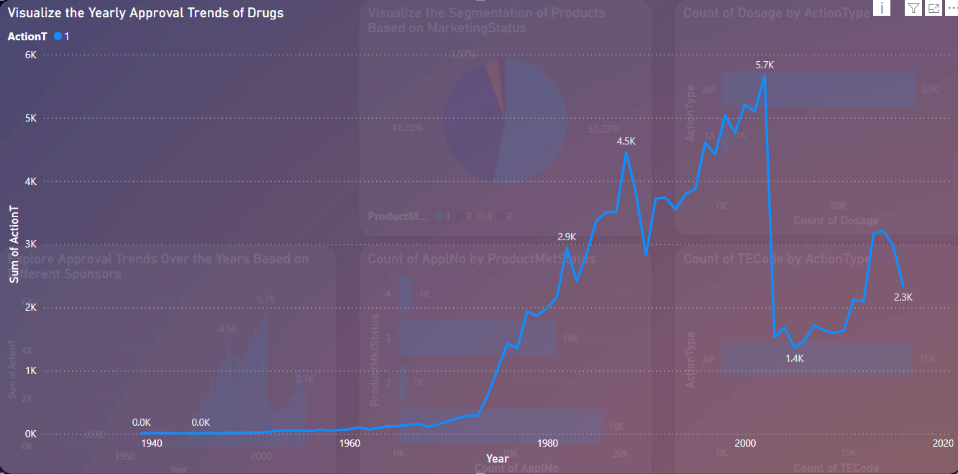
Visualize the Yearly Approval Trends of Drugs
Streamline Approval Processes: Simplify and optimize the approval workflow within regulatory bodies to reduce the time taken for drug approvals.
Priority Reviews: Introduce or expand programs like priority review vouchers for drugs that address unmet medical needs, which can expedite the approval process
Invest in Research & Development: Increase investment in R&D to boost the pipeline of innovative drugs.
Collaborative Research: Encourage collaborations between pharmaceutical companies and academic institutions to accelerate the discovery of new drugs.
Incentives for Orphan Drugs: Provide additional incentives for the development of orphan drugs, which may have a faster approval pathway due to their impact on rare diseases.

Slide 4
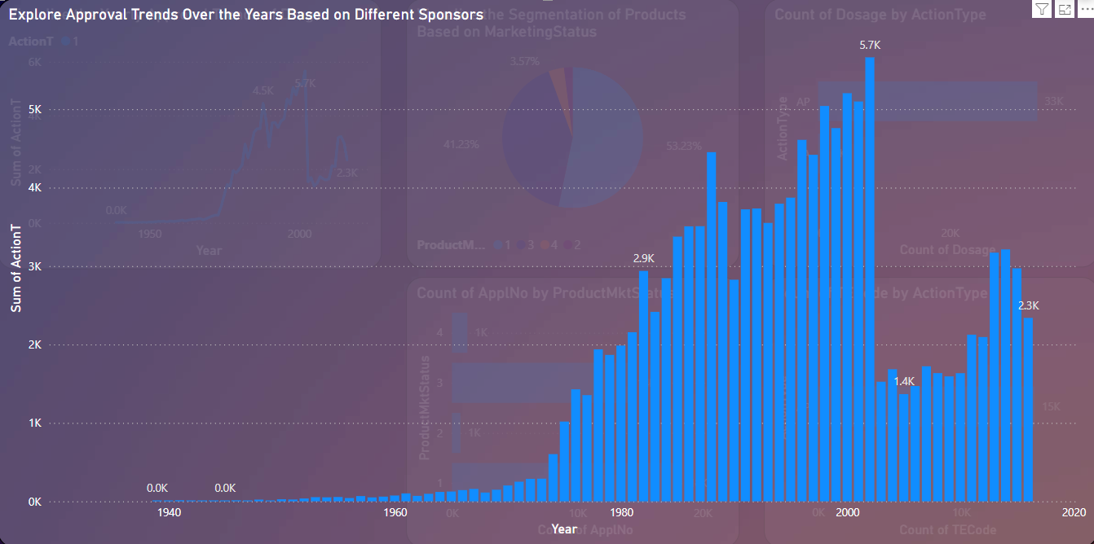
Explore Approval Trends Over the Years Based on Different Sponsors
Steady Increase (1960s-1990s):
There is a noticeable increase in drug approvals starting around the 1960s, with a significant rise continuing through the 1970s and 1980s.The peak appears to be in the late 1990s or early 2000s, where the number of approvals reaches its highest point.
Peak Approval Period (1990s):
The highest point in approvals seems to occur around the late 1990s, with a peak at 5.7K approvals in a particular year. This period represents the most active phase in terms of drug approvals.
Decline Post-Peak (Early 2000s):
After reaching the peak, there is a decline in drug approvals starting in the early 2000s.The drop appears significant, indicating potential changes in the regulatory environment, industry focus, or other factors affecting approval rates.
Recent Trends (2010s):
In the most recent years (2010s), there seems to be a recovery with approvals stabilizing but not reaching the peak levels of the 1990s

Slide 5
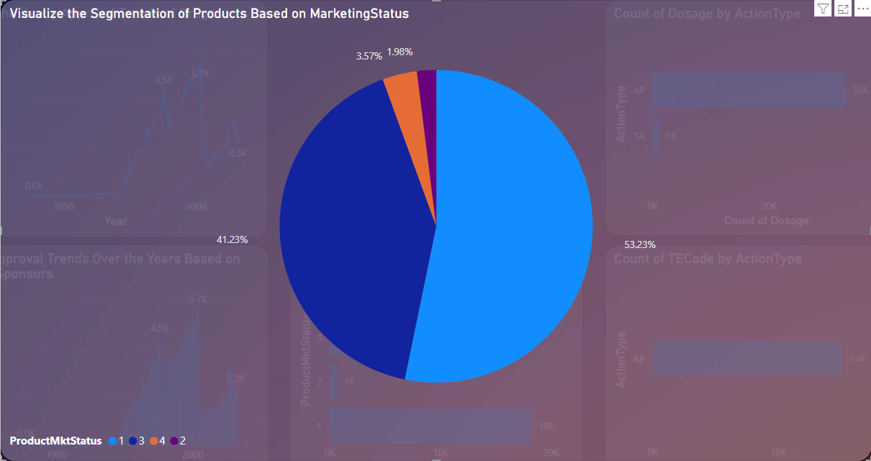
Visualize the Segmentation of Products Based on Marketing Status
Analyze Sales Data: Use data analytics to track sales performance across different Marketing Status categories and adjust strategies accordingly.
Customer Feedback: Collect and analyze customer feedback to identify preferences and trends that could lead to the development of products in new Marketing Status categories.
Focus on Patient Needs: Develop products that cater to specific patient groups, which may require different Marketing Status categories.
Patient Advocacy: Engage with patient advocacy groups to understand unmet needs and develop products that can fill those gaps, increasing segmentation
Develop New Products: Encourage the development of new products to increase representation in less common Marketing Status categories.

Slide 6
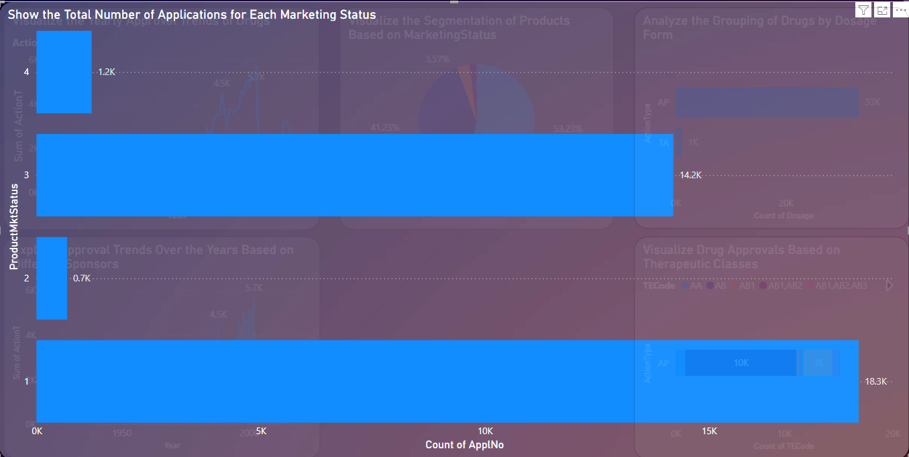
Show the Total Number of Applications for Each Marketing Status
Simplify Regulatory Requirements: Work closely with regulatory bodies to simplify the application process, making it easier and less time-consuming for companies to submit applications.
Provide Clear Guidelines: Offer clear and comprehensive guidelines on application requirements to reduce errors and rejections, encouraging more submissions.
Educational Programs: Develop educational programs and workshops to educate potential applicants on the application process, benefits, and requirements.
Outreach Campaigns: Launch outreach campaigns targeting pharmaceutical companies, startups, and research institutions to raise awareness about the importance of applying for different Marketing Status categories.
Offer Incentives: Provide financial incentives, such as reduced application fees or tax benefits, to encourage more companies to submit applications.

Slide 7
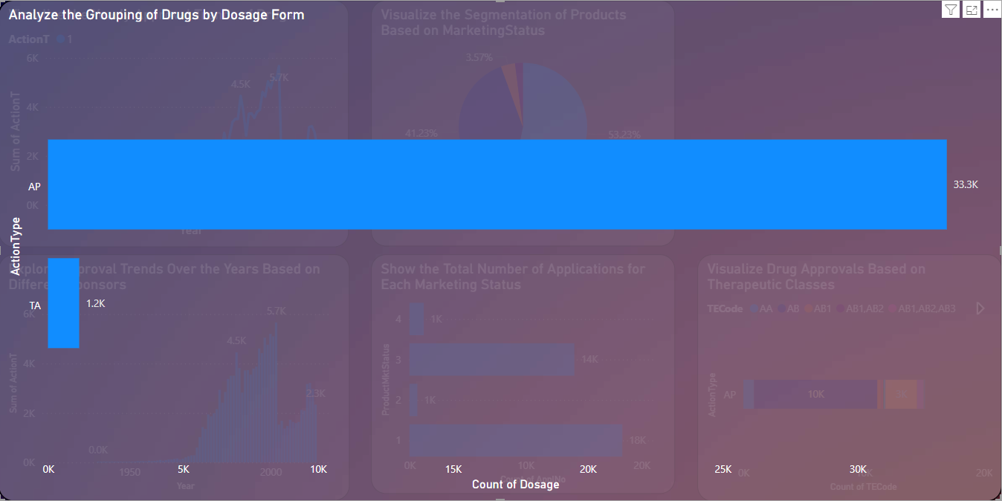
Analyze the Grouping of Drugs by Dosage Form
The bar chart titled "Analyze the Grouping of Drugs by Dosage Form" presents data on the count of drug dosages by action type. The chart indicates two primary action types:
Approval(AP)
This category has the highest count of dosages, reaching approximately 33.3K.
Therapeutic Area(TA)
This category shows a much lower count, approximately 1.2K.
Key Observation:
The AP action type significantly dominates the count of drug dosages, with 33.3K entries, indicating that this is the most common dosage form or action type used.
In contrast, the TA action type has a comparatively minimal presence with only 1.2K entries.

Slide 8
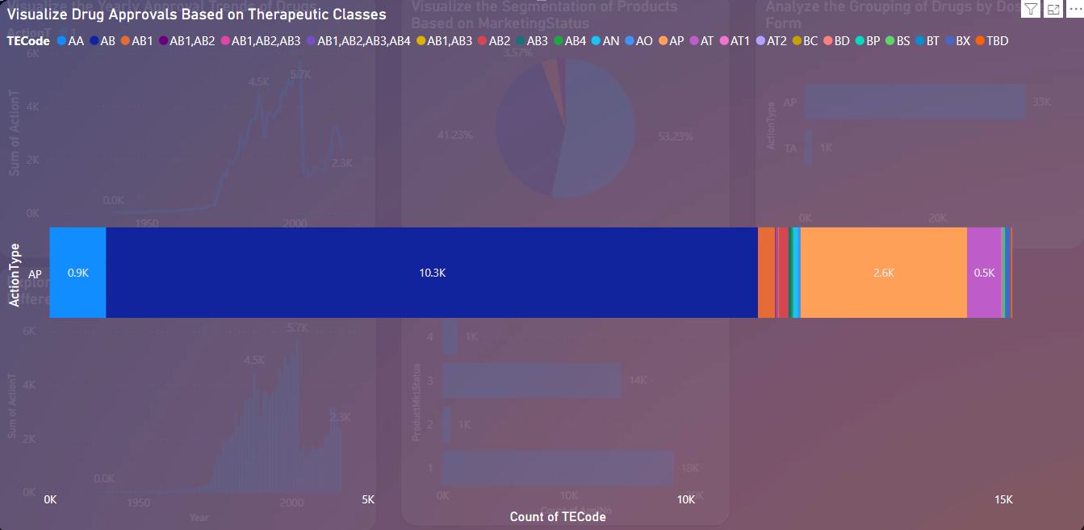
Visualize Drug Approvals Based on Therapeutic Classes
Action Types:
AP (10.3K occurrences)
TA (2.6K occurrences)
TECodes:
A variety of therapeutic classes (e.g., AA, AB, AB1, AB2, etc.) are color-coded and distributed across the action types.
The distribution indicates that certain TE Codes are more common in the "AP" action type and others in "TA."
Main Observations:
The majority of the approvals fall under the "AP" action type, with some contributions from "TA."
The color distribution suggests the presence of multiple TE Codes, with specific TE Codes being more prevalent in certain action types.

Slide 9
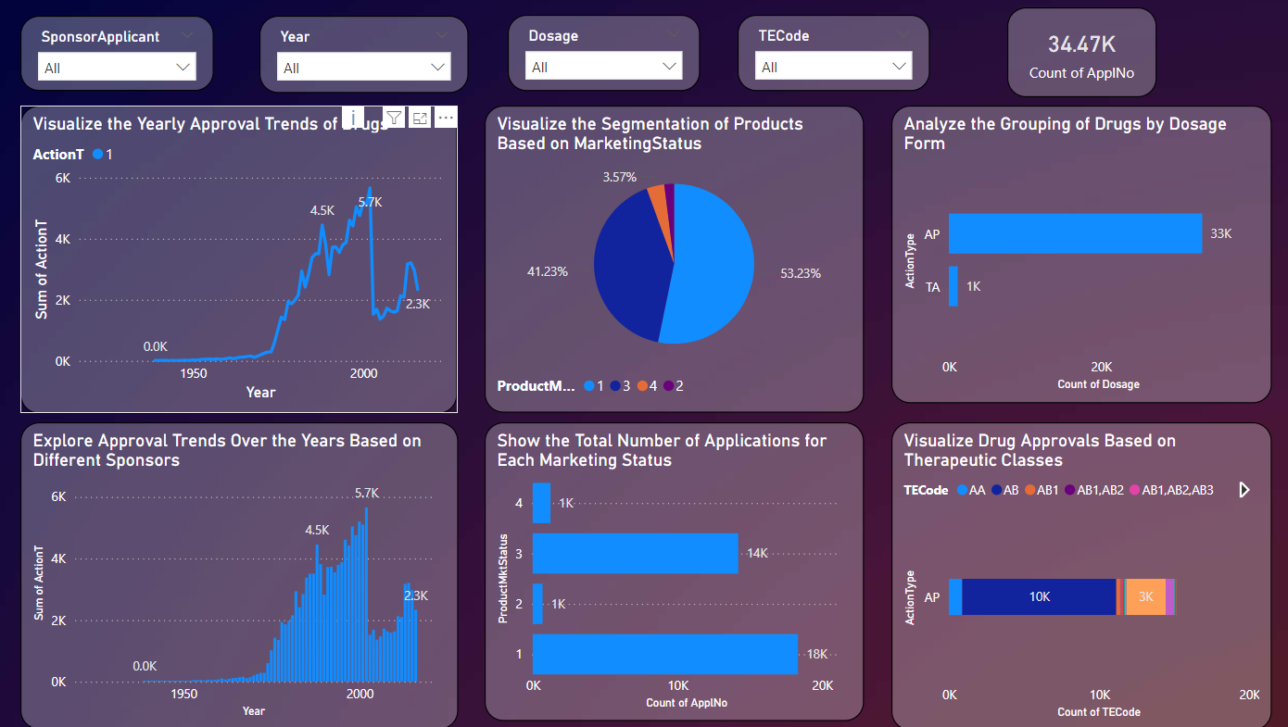
Final report

Slide 10

Thank You

